Slide 1
Leadership Structure in the Bible
Ecclesiology Notes, pages 35-85
OT
•
Inter-testament
•
NT
Dr. Rick Griffith, Singapore Bible College
BibleStudyDownloads.org
"Our bylaws specifically state that the will of God cannot be overturned without a 2/3 majority vote."

Slide 2
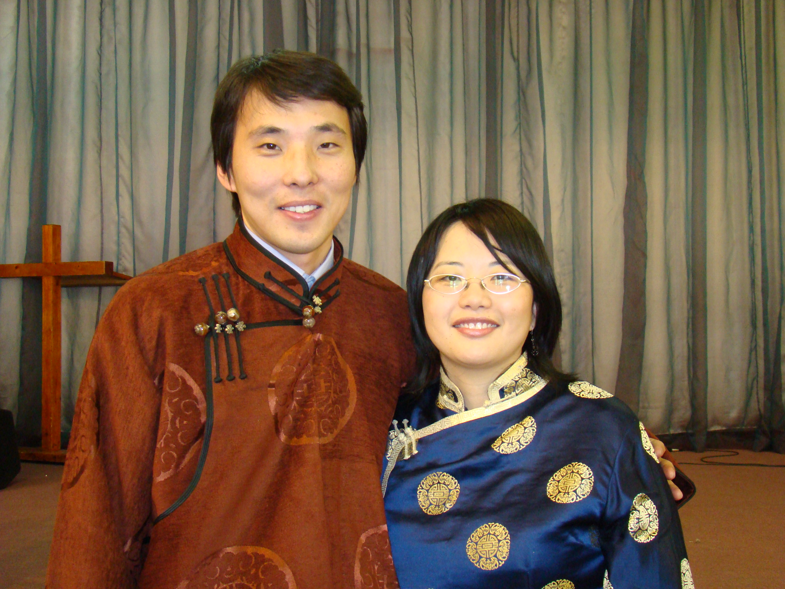
Church Leadership
35
What does it take?

Slide 3
Secular versus Pastoral Leadership: What's the Difference?
35
Secular
Pastoral
Appointed
Divine call
Physical needs
Spiritual needs
Highly educated
Calling qualif.
Voice of people
Listen to God
Directing
Leading
The Key Principle
Notes:
3

Slide 4
Secular versus Pastoral Leadership: What's the Difference?
35
Secular
Pastoral
Rancher
Shepherd
Profit motive
Glorify God
Own interests
Will of God
Power & image
Others concern
Authoritarian
Servant leader
The Key Principle
Notes:
4

Slide 5
Secular versus Pastoral Leadership: What's the Difference?
35
Secular
Pastoral
Wealthy leaders
Poor pastors
Selfish
Selfless
Position
Spiritual Qualif.
Boss (CEO)
Servant of all
Pride, ego
Meek humility
The Key Principle
Notes:
5

Slide 6
Secular versus Pastoral Leadership: What's the Difference?
35
Secular
Pastoral
Depend on self
Depend on God
Served
Serve
Impatient
Patient
Dishonesty
Integrity
Own benefit
Sacrificial
The Key Principle
Notes:
6

Slide 7
Secular versus Pastoral Leadership: What's the Difference?
35
Secular
Pastoral
Human sources
Bible
Temporal results
Eternal reward
Immoral OK
Morality
Time bound
Timeless
Duty
Call
The Key Principle
Notes:
7

Slide 8
Secular versus Pastoral Leadership: What's the Difference?
35
Secular
Pastoral
One birth OK
Born again
Paid followers
Volunteers
Complaining OK
Contentment
The Key Principle
Notes:
8

Slide 9
My Key Leadership Principle:
35
Be faithful (1 Cor. 4:1-2)
Help the poor (Isa. 58:7-8)
Love HIV sufferers
Teach children (Matt. 18:1-10)
Be an example (1 Pet. 5:3)
Notes:
9

Slide 10
My Key Leadership Principle:
35
Preach sincerely (1 Thess. 2:10)
Maintain unity (Eph. 4:1)
Notes:
10

Slide 11
What Should Leaders Aim For?
36
Numerical church growth is not a NT emphasis
(1 Cor. 4:2)

Slide 12
Scriptural Marks of a Healthy Church
36
Healthy churches...
are measured in spiritual rather than numerical terms
follow biblical rather than cultural patterns of ministry
are based on theological rather than sociological foundations
Kenneth O. Gangel, "Marks of a Healthy Church," Bibliotheca Sacra 158 (October-December 2001): 467-77

Slide 13
Scriptural Marks of a Healthy Church
36
Healthy churches...
focus on a ministry model rather than a marketing model
adopt scriptural rather than secular models of leadership
Kenneth O. Gangel, "Marks of a Healthy Church," Bibliotheca Sacra 158 (October-December 2001): 467-77

Slide 14
Biblical Leadership Principles
37
Personal Leadership
• God's Priorities
• Adapt Your Style
• Serve People
2. Selecting Leaders
• Delegate
• Spiritual Qualities
• Build a Team
3. Other Principles

Slide 15
LEADERSHIP STRUCTURE IN THE OLD TESTAMENT
38
Is there a pattern?

Slide 16
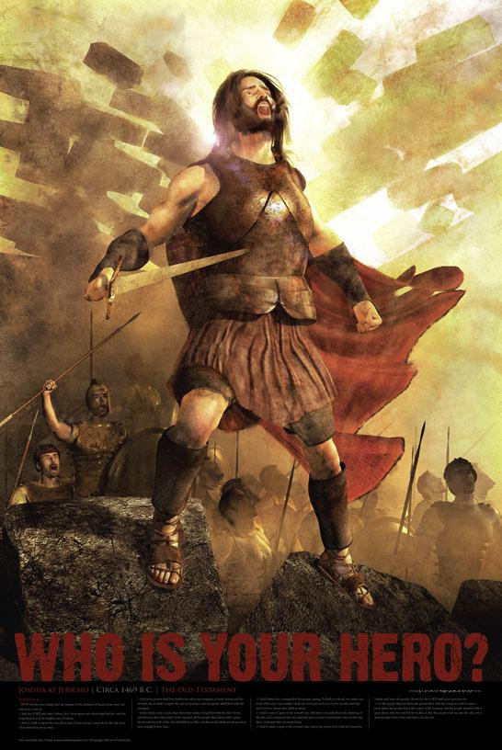
约书亚记
任务
无法完成的
THE SINGLE LEADER MODEL
占领
Dr. Rick Griffith, 新加坡神学院
BibleStudyDownloads.org

Slide 17
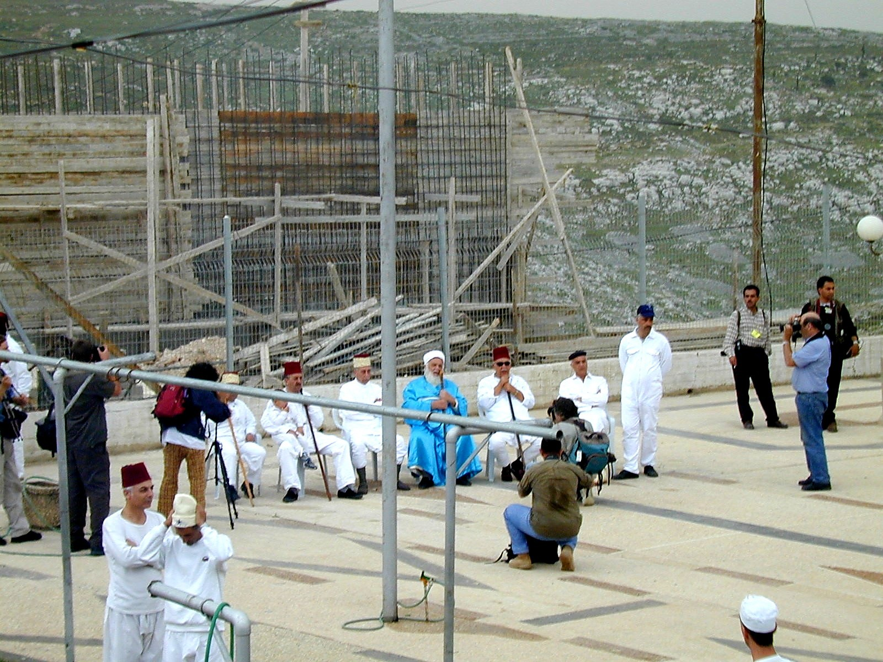
38
The Elders of Israel
What do you learn about the elders of Israel from your assigned verses?
Samaritan Elders Today

Slide 18
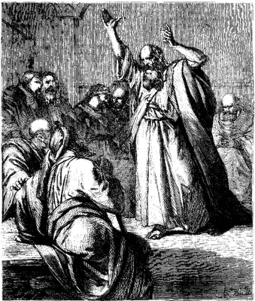
The Elders of Israel
48
Elders are found throughout the nation's history
Elders were prominent even when God spoke revelation through a single man such as Moses (Exod. 3:16, 18; 4:29, etc.) or a prophet like Elijah (2 Kings 6:32)
There was always a plurality of elders in the OT—only once does the word appear in the singular ("elder" in Isa. 3:2)

Slide 19
The Elders of Israel
48
Elders led at various levels: national, regional, city, house
Elders ruled other nations, such as Midian (Num. 22:4), Moab (Num. 22:7), and Gibeon (Josh. 9:11).
Once Israel's elders prophesied (Num. 11:25-26).
Elders were commanded to teach the people God's laws every seven years (Deut. 27:1-8; 31:9-10), which they did under Josiah (2 Kings 23:1-2).

Slide 20
The Elders of Israel
50
Elders were respected for their wisdom (Ps. 107:32; Prov. 31:23; Lam. 4:16; 5:12)
Elders counseled kings in their ruling (1 Kings 12:6-8, 13; 20:7-8; Jer. 26:17) and anointed kings to power (1 Chron. 11:3)
Elders submitted to prophets' instructions (Elijah in 2 Kings 6:32; Ezekiel in Ezek. 14:1)

Slide 21
The Elders of Israel
50
Elders ruled alongside other administrators: a palace administrator, the city governor, and officials (2 Kings 10:1, 5). Their decision was especially binding in postexilic times (Ezra 10:8, 14).
OT elders often failed to lead the people biblically
Elders will rule over Israel in the future millennial reign of Christ (Isa. 24:23)

Slide 22
The Elders of Israel
51
Unfortunately, the OT gives no explicit instructions on who they were or how to select them. Yet the term itself implies that each group of elders was composed of older, mature men.

Slide 23
Key Questions to Answer
What is the biblical form of church government?
Who has the ultimate authority in local church matters?
How is congregational say balanced with biblical commands to respect leaders?

Slide 24
OUTLINE
Introduction
Four facts
Basic approach
Church Government in the NT
Key functions of an Elder
Key function of a Deacon
Appointment of church officers

Slide 25
OUTLINE
Body:
Decision making in the local church
Proposed form of church government
Leaders-Congregation dynamics
Conclusion
Sources

Slide 26
Four facts:
The Bible does not explicitly indicate a form of church government.
The Bible does not command the church to adopt any particular form of government.
INTRODUCTION

Slide 27
Four facts:
Two church offices are mentioned in the NT:
Elder (Pastor/Overseer/Bishop – Acts 14:23; Phil. 1:1; Titus 1:5)
Deacon (servant) – Acts 6:3
INTRODUCTION

Slide 28
Four facts:
The qualifications of these two church officers are clearly stated in the Bible:
Elder (1 Tim. 3:1-7; Titus 1:5-7)
Deacon (Acts 6:3; 1 Tim. 3:8-13)
INTRODUCTION

Slide 29
Our Basic Approach
INTRODUCTION
We will determine the correct form of church government by understanding the key qualifications of elders and deacons in the NT since they are the only church offices noted.

Slide 30
两个问题：
谁拥有教会最后的发言权？
圣经如何论到教会领袖的模式？
30

Slide 31
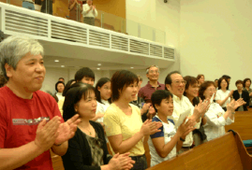
I. 会众在教会里拥有最终极的权利
31

Slide 32
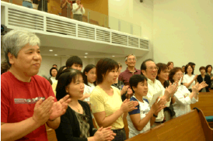
会众权利
执行教会纪律（太18:17）
「就告诉教会……」
挑选领袖（徒6:3）
「当从你们中间选出……」
传授正统的教义：
「我当日传给你们的，原是从主领受的……」（林前11:23）
「亲爱的弟兄啊……总要试验那些灵」（约一4:1）
「为……真道竭力的争辩。」（犹3）
32

Slide 33
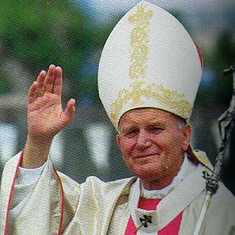
主教级
教会结构图
（简化）
244a
会督
圣公会
信义会
卫理公会
东正教
天主教
教堂牧师
教堂牧师
教堂牧师
会吏
会吏
会吏
会友
会友
会友
33

Slide 34
基本长老会结构图
244a
长老会
主任牧师
主任牧师
主任牧师
长老
（议会）
长老
（议会）
长老
（议会）
会友
会友
会友
34

Slide 35
区域长老会结构图
教区
长老群
长老群
主任牧师
主任牧师
主任牧师
主任牧师
主任牧师
主任牧师
长老
（议会）
长老
（议会）
长老
（议会）
长老
（议会）
长老
（议会）
长老
（议会）
会友
会友
会友
会友
会友
会友
35

Slide 36
最高层长老会结构图
长老大会
教区
教区
长老群
长老群
长老群
长老群
长老（议会）
长老（议会）
长老（议会）
长老（议会）
长老（议会）
长老（议会）
长老（议会）
长老（议会）
长老（议会）
长老（议会）
长老（议会）
长老（议会）
会友
会友
会友
会友
会友
会友
会友
会友
会友
36
会友
会友
会友

Slide 37
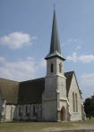
浸信会又如何？
教会的自治权
37

Slide 38
两个问题：
谁拥有教会最后的发言权？
圣经如何论到教会领袖的模式？
38

Slide 39
II. 圣经里的教会领袖模式是由长老组成.
39

Slide 40
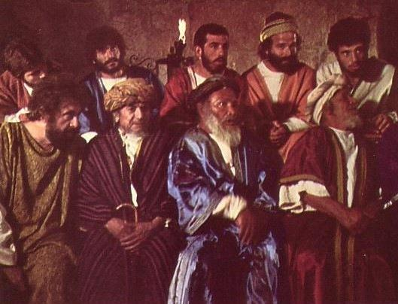
由长老领导的摩西时代
与摩西一起
领导的长老
主前1400年
「你去招聚以色列的长老，对他说……」（出3:16）
40

Slide 41
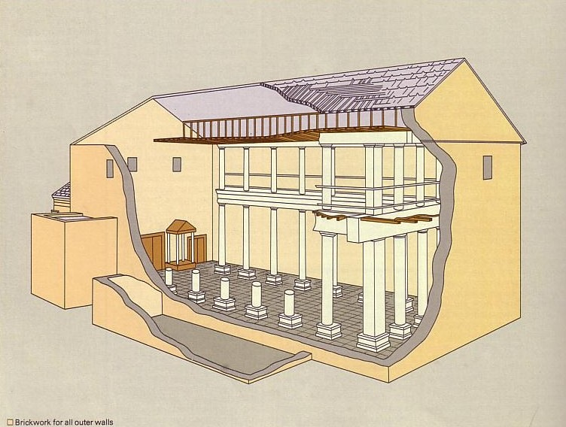
谁领导犹太会堂？
长老领导
的犹太会堂
主前600年
与摩西一起
领导的长老
主前1400年
41

Slide 42
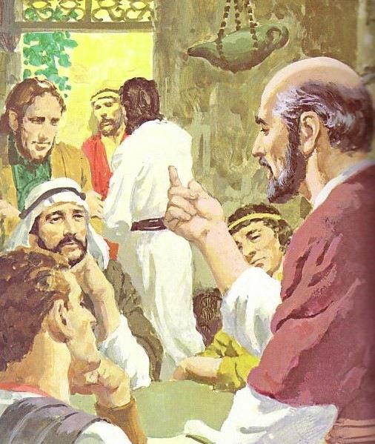
神在各个的时代里都主张团体领袖
长老领导
的犹太会堂
主前600年
新约
长老
与摩西一起
领导的长老
主前1400年
42

Slide 43
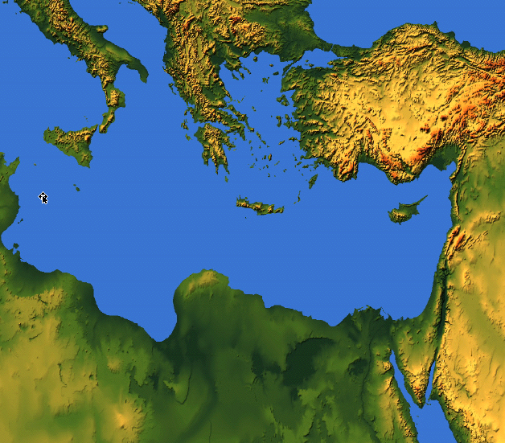
各处所提及的长老
长老 = 监督 = 会督 = 牧师
55
耶路撒冷（主后47）
CNV Acts 11:30 他们就这样行了， 由巴拿巴和扫罗经手送到长老们那里。
以弗所（主后57)
CNV Acts 20:17他从米利都派人去以弗所， 请教会的长老来。
加拉太（主后48）
NIV Acts 14:23 两人在各教会为他们指派了长老； 禁食祈祷之后， 就把他们交讬给所信的主。
革哩底（主后66）
NIV Titus 1:5我从前留你在克里特岛， 是要你办好没有办完的事， 并且照我所吩咐的， 在各城设立长老。
腓立比（主后62）
NIV Philippians 1:1 基督耶稣的仆人保罗和提摩太， 写信给所有住在腓立比， 在基督耶稣里的圣徒、 监督和执事:
旁非利亚、加拉太、加帕多家、亚洲及庇推尼（主后64）
彼5:1「我这作长老……劝你们中间与我同作长老的人。」 （参1:1）

Slide 44
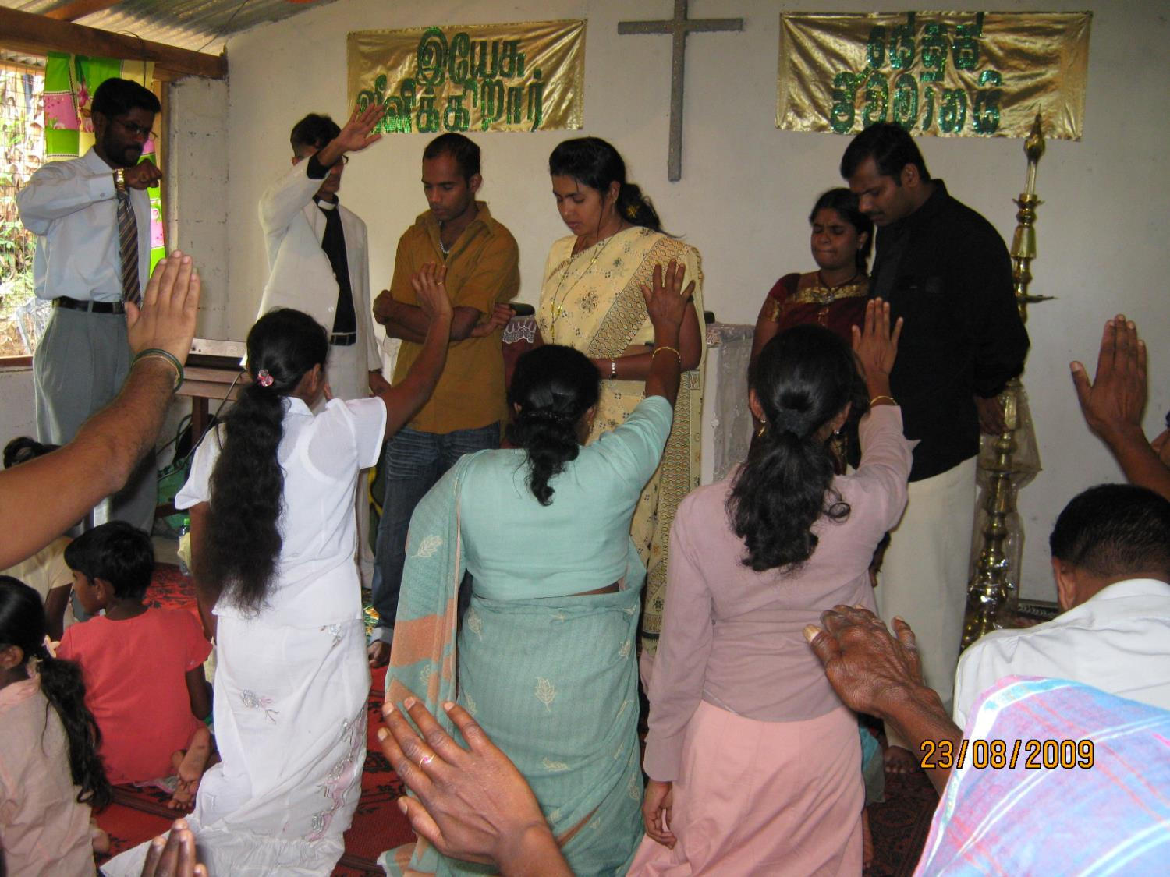
长老当作什么？
44

Slide 45
长老的牧养职分
(a) 教导的长老：
INTRODUCTION
「作全群的监督」（徒20:28）
「善于教导」（帖前5:12；提前3:2；多1:9b）
良好的圣经基础（多1:9a）
教导神的计划（徒20:20,27）
受薪制的教导（提前5:17）
最高职位：教导（徒6:1-7）
长老领导执事（腓1:1）
BODY
45

Slide 46
长老的三个牧养工作
236c1
教导
提前3:2；5:17

Slide 47
236a 6b
长老和执事的关系
模式一：主任牧师带领执事会
主任牧师
执事会
不符合圣经
47

Slide 48
236a 6b
长老和执事的关系
模式二：主任牧师与执事会平起平坐
执事会
主任牧师
不符合圣经
48

Slide 49
236a 6b
长老和执事的关系
模式三：执事带领长老/牧者
执事会
主任牧师
不符合圣经
49

Slide 50
236a 6b
长老和执事的关系
模式四：长老团带领执事会
主任牧师
执事会
50

Slide 51
236a 6b
长老和执事的关系
使徒带领「七个执事」
使徒
DDDDDDD
DDDD
DDDDD
「七位执事」
（徒21:8）
51

Slide 52
236a 6b
长老和执事的关系
模式五：长老与执事的委员会
长老
DDDDDDD
DDDD
DDDDD
52

Slide 53
236c1
长老的三个牧养工作
教导
提前3:2；5:17
牧师—教师
弗4:11
牧养
（保护与领导） 彼前5:1-4; 徒20:29,35; 帖前5:12
53

Slide 54
三种类型的长老
236b
「那善于管理教会的长老，当以为配受加倍的敬奉，那劳苦传道教导人的，更当如此。」（提前5:17）
所有长老
教导、保护、领导、服事、见证
无领薪或 $ 若有需要
领薪的经理
$
传道人及老师 $$

Slide 55
长老的三个牧养工作
236c1
行政管理
「服事、关顾及见证」 提前3:1，4-5；5:17
Episkopos =Epi「在上面」+skopos「看」= 「守望」
教导
提前3:2；5:17
牧师—教师
弗4:11
牧养
（保护与领导） 彼前5:1-4; 徒20:29,35; 帖前5:12
55

Slide 56
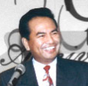
分担领导
圣经支持
长老群
而是多个长老
不是一个长老……
56

Slide 57
总结
INTRODUCTION
因此，新约呈现的长老功能是
教导、牧养及行政管理
BODY
57

Slide 58
231
执事的主要功能
INTRODUCTION
服事
a. 徒6:1-6
b. 提前3:8-13
BODY
58

Slide 59
注意：
执事不是统治者，他们是附属在长老的治理之下。
执事辅助长老，尤其是减轻长老身负教会繁重的事工。
INTRODUCTION
BODY
59

Slide 60
注意：
新约里并没有记载执事如同长老一样拥有治理教会的权利，也并没记载执事被吩咐去作教导圣经或正统的教义。
INTRODUCTION
BODY
60

Slide 61
236a
设立教会管理的型式
INTRODUCTION
长老（管理/作抉择）
BODY
执事（服事）
会众（委任）
61

Slide 62
长老－会众动力
INTRODUCTION
长老
看自己如同仆人
爱
BODY
看他们如同领袖
会众
62

Slide 63
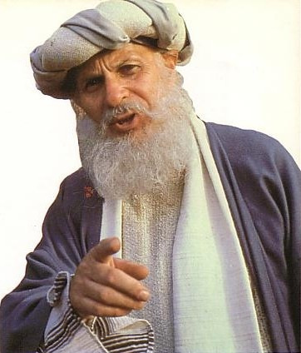
长老的资格是什么？
63

Slide 64
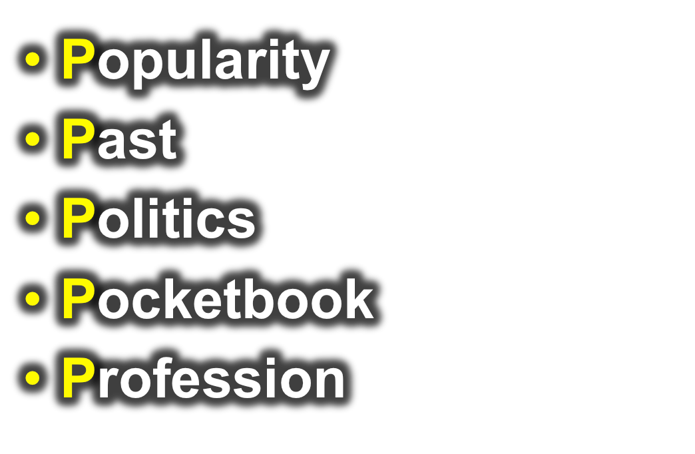
如何在教会里挑选领袖？
好名声
背景
精明
皮夹子
专业
64

Slide 65
教会当如何挑选领袖？
圣经例子：
会众决定/推举
INTRODUCTION
身体
a. 使徒
徒1:12-26——会众选出，使徒指派
b. 执事
徒6:3——会众选出，使徒指派

Slide 66
教会同工的指派
INTRODUCTION
使徒（例：保罗）或他的助手按立长老
a. 徒14:23
b. 多1:5
身体
66

Slide 67
Conclusion
63
With the demise of the apostolic age, it is therefore logical and scriptural to have the congregation choose both the elders and deacons of the church.
INTRODUCTION
BODY

Slide 68
How to Choose Leaders
The process of choosing or nominating and the election process should be clearly documented in the local church constitution in order to avoid confusion and misunderstanding.
(The constitution should also give the process of hiring and firing both elders and deacons even though the Bible is silent on this matter.)
INTRODUCTION
BODY

Slide 69
提摩太前书
教会生活与次序

Slide 70
领袖的品质
223
他们是谁？监督 (长老，主教，牧师) 和执事
品质是指领袖现在的生活
如果领袖失败，他必须离职。
所有的品质是必需和相等重要得
品格是比才干重要 （只有两种特性有关才干）
管理自己的家重于工作
应该要合格才可以
1. 给于敬虔方向
2. 教会可以避免不好或不熟练的领袖带来的不必要问题

Slide 71
监督(O) 与执事(d) 的品质
224
一般的名誉
(察觉品格)
无可指摘 (O)
教外有好名誉 (O)
庄重 (O & D)

Slide 72
监督(o)与执事(d)的品质
225
II. 家庭生活 (如有接婚)
一个妻子的丈夫 (O & D)
妻子是被庄重的，不说谗言，有节制，凡事忠心。 (D)
儿女凡事敬重顺服 (O & D)

Slide 73
监督(o)与执事(d)的品质
225
III. 反面的特征
不轻易发怒 (O)
不暴力 (O)
与人无争 (O)
不是初信主的 (O)
不贪不义之财 (O & D)
不好酒；有节制的 (O & D)

Slide 74
监督(o)与执事(d)的品质
226
IV. 正面的特征
乐意接待客旅 (O)
切合实际 (O)
先受考验 (D)
真诚 (D)
善于教导 (O)

Slide 75
提摩太前书 3:8-13 (新译本)
232
⁸,照样，执事也必须庄重，不一口两舌，不酗酒，不贪不义之财。 ⁹用清洁的良心持守信仰的奥秘。 ¹⁰他们也必须先受考验，若没有可责之处，然后才让他们作执事。 ¹¹照样，他们的 妻子 {¹¹可解作女执事} 也要庄重 不说？？言，有节制，凡事忠心。¹²执事 只可以作一个妻子的丈夫，善于 管理儿女和自己的家。¹³那善于作执事的，就为自己得了好的位分，也因着相信基督耶稣得到大大的胆量。

Slide 76
对女人的观点- 提摩太前书3:11
232
Gynaikos (gunaiko.j) 可以翻译成 “女人” 或 “妻子”
用词至少有六个观点:
女人
长老和执事的妻子
像执事但在他们以下
执事的妻子
女执事, 或
执事的妻子称为女执事
76

Slide 77
支持“像执事但在他们以下”
232
(4) “They are a group by themselves, not just the wives of the deacons nor all the women who belong to the church.…On the other hand, the fact that no special and separate paragraph is used in describing their necessary qualifications, but that these are simply wedged in between the stipulated requirements for deacons, with equal clarity indicates that these women are not to be regarded as constituting a third order in the church, the office of deaconess, on par with and endowed with authority equal to that of deacons” (William Hendricksen, Pastoral Epistles, NTC, 346; Donald Guthrie, The Pastoral Epistles, 85; See my p. 232, note 2).
77

Slide 78
Supporters of "Deacon Wives"
80
Translations: NIV, KJV, NKJV, GNB, Beck, LB, Phillips
Scholars:
Warren Wiersbe, 51-52
Earle, Expositors Bible Commentary, 11:368
Litfin, Bible Knowledge Commentary, 2:238 says the view has a slim advantage.

Slide 79
Supporters of "Deaconesses"
80
Translations: NIV footnote, Williams trans.
Scholars:
James B. Hurley, Man and Woman in Biblical Perspective, 229-33
Kelly, 83
Newport J. D. White, in Expositors Greek Testament, 4:115-16
J. H. Bernard, The Pastoral Epistles, 58-59
Walter Lock, A Critical and Exegetical Commentary on the Pastoral Epistles, ICC, 40-41

Slide 80
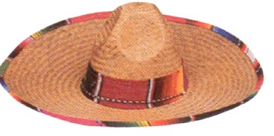
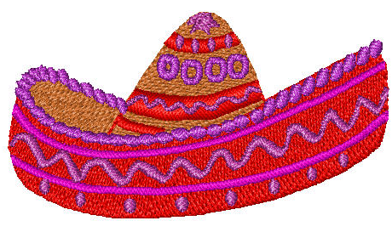
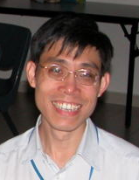
To change to a biblical structure, can't a church just call the present deacons "elders"?
84a & 90j
Deacon
Deacon
Elder
Elder

Slide 81
Elder-Deacon Contrasts
84a
No. There are many differences between them…
Deacon
Elder
Qualifications
Character
Character + Teaching
Role (Gifting)
Administration
Pastoral
Time Involved
Much
Even more extensive
Age
Younger
Older

Slide 82
Leadership by elders and congregational authority are not contradictory
90 i

Slide 83
Summary
The elders rule the church and minister the Word of God to build up the body of Christ whilst the deacons (a subordinate class of officers) are to serve the body of Christ as directed by the elders.
INTRODUCTION
BODY
CONCLUSION

Slide 84
Summary
Two vital points to bear in mind:
It must not be forgotten that no institution or structure is perfect as man is fallible;
The goal of the leaders and the congregation is not to manage the church successfully but to glorify God which sometimes happens through failures.
INTRODUCTION
BODY
CONCLUSION

Slide 85
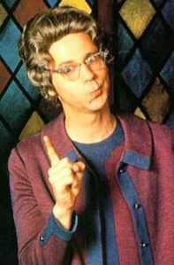
Biblical Decision Making
86
How were decisions made in the Bible?

Slide 86
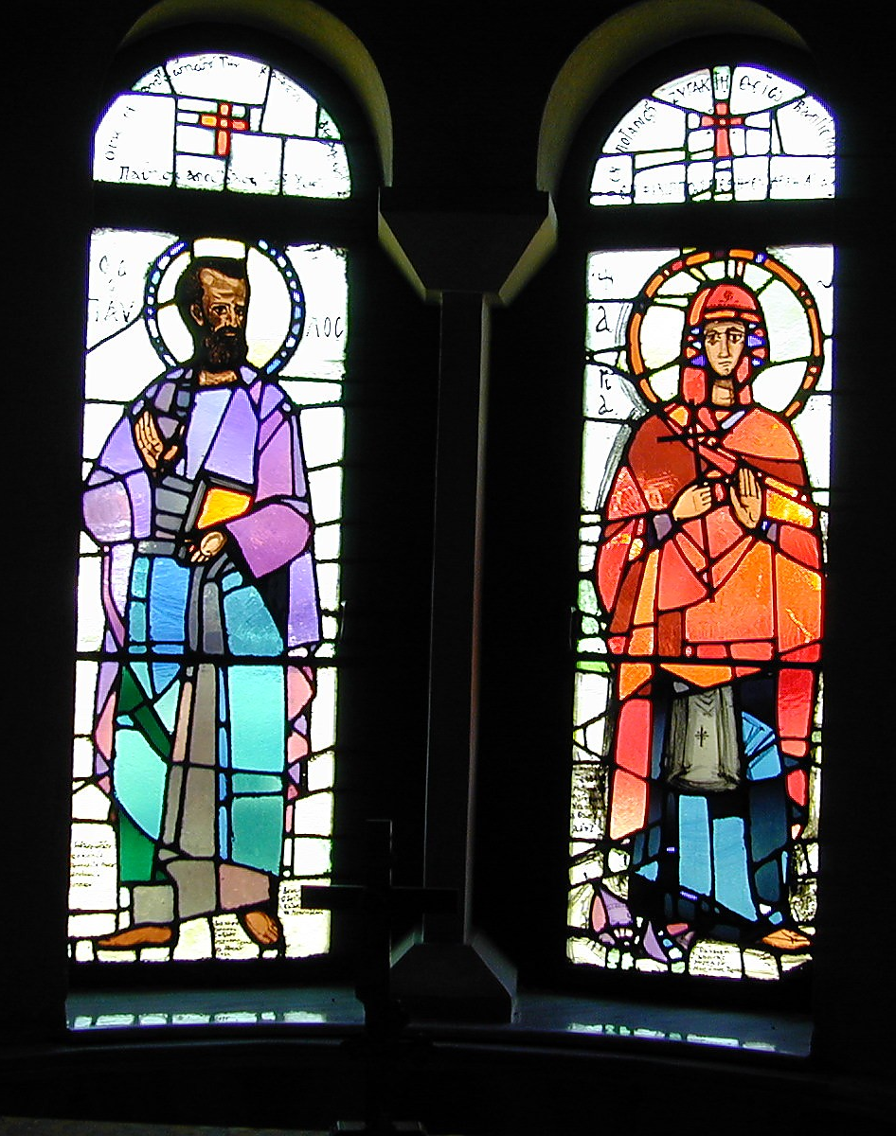
Methods Used
86
Leader's Choice
Lots
Urim & Thummin
Fleece
Others?
Paul & Lydia in Philippian Church

Slide 87
Making Key Decisions
Ecclesiology Notes, pages 35-85
What percentage was the biblical pattern?
"Our bylaws specifically state that the will of God cannot be overturned without a 2/3 majority vote."

Slide 88
Key Decisions in Acts 15
86-87
Circumcision at the Jerusalem Council (vv. 1-35)
Conflict over John Mark's Restoration (vv. 36-40)

Slide 89
Decision making in the local church
88
INTRODUCTION
From a biblical viewpoint:
Apostles (over all churches)
Elders (over local issues)
Congregation (for serious cases)
Matt. 18:17
Acts 15:22
1 Cor. 5:4-5
BODY

Slide 90
Attention:
88
Therefore it is only wise to state explicitly in the local church constitution the confines of the decision-making prerogative by both the elders and the congregation.
INTRODUCTION
BODY

Slide 91
Discussion Questions
89-91
Questions on Elders & Deacons
Questions on Normative Structure

Slide 92
SOURCES
Grudem, Wayne. Systematic Theology: An Introduction to Biblical Doctrine (Leicester, England: IVP and Grand Rapids, Michigan: Zondervan), 904-949.
Reed, Kevin. Biblical Church Government http://www.swrb.com/newslett/actualNLs/bcg_ch02.htm.

Slide 93
This presentation is edited from…
Presenter : Loke Chee Kiong
Topic : Church Government

Slide 94
Black
Notes:
94

Slide 95
教会论链接地址 BibleStudyDownloads.org
免费获得该讲解!
圣经学习下载
Notes:
CH Church (Ecclesiology)

